Slide 1
Federal Health Information Model (FHIM) Presentation for NIEM Health and Human Services Domain
Steven Wagner

Slide 2

Federal Health Information Model
Health data information model
Designed to support the federal health enterprise
Standardizes and harmonizes content
Open source Model Driven Health Tools (MDHT) automates generation of health information exchange (HIE) standards
2
Notes:
A logical information model of health data developed in collaboration with the federal partner agencies designed to support the federal health enterprise
Standardizes and harmonizes content (information, terminologies and value sets) across federal partner and standards organizations based on their priorities (e.g., MU) and use cases and
Integrates with open source Model Driven Health Tools (MDHT) to automate the generation of health information exchange (HIE) standards (e.g., interoperability specifications)

Slide 3
Federal Health Information Model…continued
Generates HIE standards for multiple Platform Specific Models (PSMs) (e.g., HL7 CDA, HL7 FHIR, NIEM, etc.)
Integrated into a robust FHA HIE framework to standardize information across the federal health enterprise
Provides models, tools and processes to help organizations implement information exchange standards
2
Notes:
Can generate HIE standards for multiple Platform Specific Models (PSMs) (e.g., Health Level 7 Consolidated Document Architecture (CDA), HL7 Fast Healthcare Interoperability Resources (FHIR), National Information Exchange Model (NIEM), etc.)
The FHIM, associated terminology models and value sets and MDHT have been integrated into a robust FHA HIE framework to standardize information across the federal health enterprise
The framework provides the models, tools and processes to help organizations (federal partners and others) implement information exchange standards

Slide 4
Benefits of the FHIM and FHA HIE Framework
Supports the broadest range of use cases and retains use case context
Can be leveraged by organizations for internal use in systems and database development
Developed using the UML (Unified Modeling Language)
The modeling process harmonizes content (information and terminology) across organizations
Can reduce the time required to define/harmonize information by as much as 50%
Support the goals and requirements of the S&I Framework
Freely available components
Notes:
Examples of federal partners leveraging the FHA HIE Framework:
VA has used FHIM information to support their business modeling efforts, their IPO models and their general standards work
DoD has used FHIM information to support their functional modeling and iEHR work
CDC has used FHIM information to support their public health reporting community S&I Framework initiative
FDA has used FHIM information to standardize and harmonize the information defined in their HL7 standards for exchanging device and regulatory information
UML is a standard that supports the exchange of modeling information between different proprietary modeling tools. This supports the export/reuse of FHIM information to other modeling tools used by federal partners.
Estimates of time that can be reduced in modeling/harmonizing information is based on several prototypes completed by the FHIM team.

Slide 5
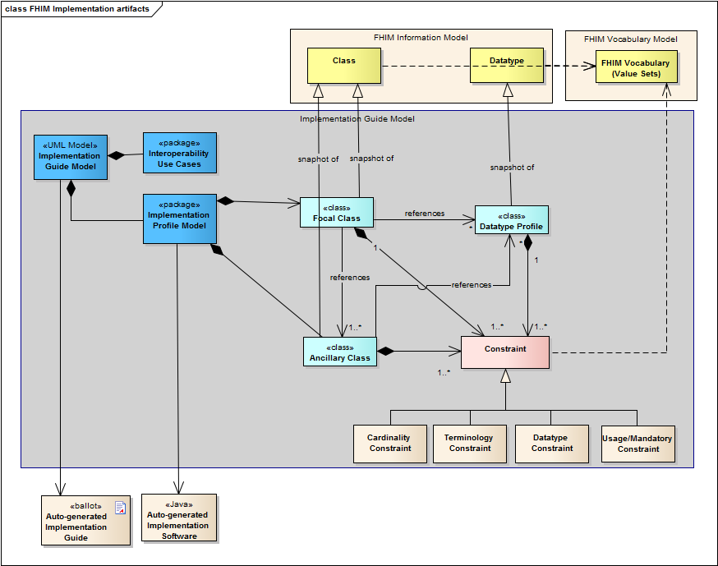
Implementation Guide Modeling Artifacts

Slide 6
FHIM Information Domains - Modeling Status
FHIM Information Domains
Information Domain | Information Modeling Status | Terminology Modeling Status
AdverseEventReporting | Complete | Complete
Allergies | Complete | Complete
Assessment | Complete | To Be Modeled
Audiology And Speech Pathology | To Be Modeled | To Be Modeled
BehavioralHealth | Partially Complete | To Be Modeled
BloodBank | To Be Modeled | To Be Modeled
CarePlan | In Progress | In Progress
ClinicalDecisionSupport | To Be Modeled | To Be Modeled
ClinicalDocument | To Be Modeled | To Be Modeled
Consultation | To Be Modeled | To Be Modeled
Dental | To Be Modeled | To Be Modeled
Dietetics | To Be Modeled | To Be Modeled
Encounter | Complete | To Be Modeled
EnrollEligibilityCOB | Complete | To Be Modeled
HealthConcern | Complete | Complete
HomeBasedPrimaryCare | To Be Modeled | To Be Modeled
Imaging | To Be Modeled | To Be Modeled
Immunizations | Complete | Complete
Lab | Complete | Complete
OncologyRegistry | To Be Modeled | To Be Modeled
Orders | Complete | Complete
FHIM Information Domains
Information Domain | Information Modeling Status | Terminology Modeling Status
PatientEducation | To Be Modeled | To Be Modeled
Person | Complete | Complete
Medications/Pharmacy | Complete | In Progress
Prosthetics | To Be Modeled | To Be Modeled
Provider | Complete | Complete
Public Health Reporting | Complete | In Progress
Radiology | To Be Modeled | To Be Modeled
SecurityAndPrivacy | Complete | Complete
SocialWork | To Be Modeled | To Be Modeled
SpinalCord | To Be Modeled | To Be Modeled
Surgery | To Be Modeled | To Be Modeled
VitalSigns | Complete | Complete
WomensHealth | To Be Modeled | To Be Modeled
Common | Complete | To Be Modeled
Datatypes | Complete | Complete
In production
3

Slide 7
Impacts
Provides a common understanding of information to be exchanged between federal partners (single source of truth)
Improves the level of interoperability that can be achieved
Reduces the time it takes to develop information exchange standards
Can improve the efficiency of developers in implementing information exchanges

Slide 8


Your Comments/
Questions?
8

